Slide 1
Loops and Control Statements in Python
Understanding Loop Control Keywords

Slide 2
Introduction to Loops/ Iterations
Iteration repeats/loops the execution of a sequence of code.
Types of Loops in Python:
- for loop
- while loop

Slide 3
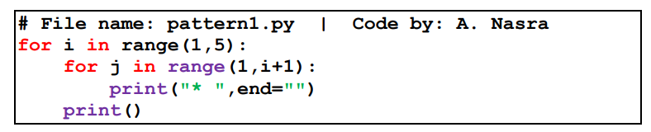
For Loop
The for statement iterates over a range of values.
These values can be a numeric range, or, as elements of a data structure like a string, list, or tuple
for item in iterable:
# Code block
Example:
for i in range(5):
print(i)

Slide 4
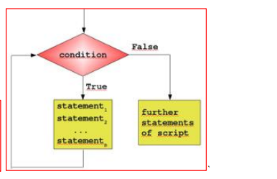
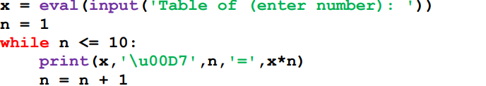
While Loop
Syntax:
while condition:
# Code block
Example:
count = 0
while count < 5:
print(count)
count += 1

Slide 5
Control Statements Overview
Control statements alter the flow of execution in loops.
Key Control Statements:
- break
- continue
- pass

Slide 6
Comparison of Control Statements
Statement | Functionality | Use Case
----------|---------------|----------------
break | Exits the loop immediately | Terminating a loop early
continue | Skips to the next iteration | Ignoring specific conditions
pass | Does nothing; acts as a placeholder | Maintaining code structure

Slide 7
Break Statement
Definition: Exits the loop immediately.
Usage: To stop iteration based on a condition.
Example:
for i in range(10):
if i == 5:
break
print(i)

Slide 8
Continue Statement
Definition: Skips the current iteration.
Usage: To skip specific values in a loop.
Example:
for i in range(10):
if i % 2 == 0:
continue
print(i)

Slide 9
Pass Statement
Definition: A null operation; does nothing.
Usage: Acts as a placeholder for future code.
Example:
for i in range(5):
if i == 3:
pass # Placeholder for future code
print(i)

Slide 10
Conclusion
Loops and control statements are essential for efficient programming in Python.
Understanding keywords like break, continue, and pass helps control flow effectively.

Slide 11
Questions?
Open the floor for any questions.

